Slide 1
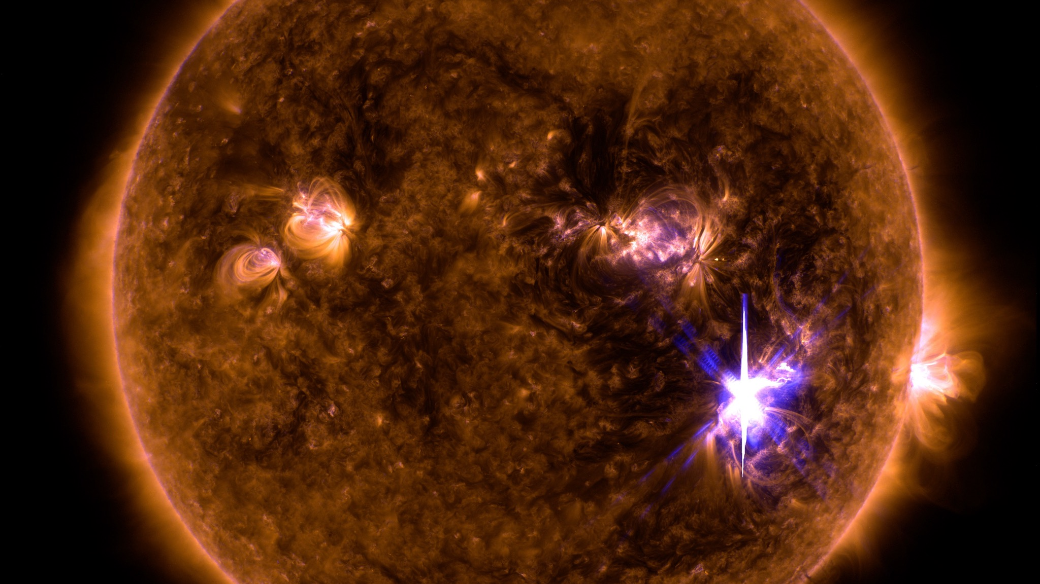
Priming Windows in
Solar–Terrestrial Coupling
A multiplicative conductivity-memory gate
linking fast EM drivers to slow gravity-wave forcing
Based on CORE-INSIGHT.md + supporting notes
Notes:
[Sources] - Provided materials: CORE-INSIGHT.md; short-note.md. - Background image (Solar flare): NASA GSFC/SDO (via NASA SVS) https://svs.gsfc.nasa.gov/vis/a010000/a012700/a012706/Sept_6_X9_Blend_131-171_2k.jpg [/Sources]

Slide 2
Core insight
Fast EM events open a short-lived amplification window that gates later gravity-wave impacts
Amplification window
Extra GW effectiveness
GW transit time
3–10 h
2–4×
6–24 h
Priming window = conductivity memory
Timing schematic
Electromagnetic drivers (flares, high-speed streams) rapidly enhance ionospheric conductivity.
That enhanced state persists for hours after the EM forcing relaxes (a “memory”).
Gravity-wave coupling efficiency depends on the conductivity state at arrival time.
Result: the EM history multiplies GW effectiveness — with essentially no reverse influence.
EM
3–10h
GW
Amplified ionospheric response
Priming-window framework
Notes:
[Sources] - Provided materials: CORE-INSIGHT.md; short-note.md. [/Sources]

Slide 3
Why this is non-obvious
Most models treat EM and GW drivers as independent, additive channels
Standard assumption
Priming-window model
Total response = EM effect + GW effect
Total response = EM + M(t) × GW
M(t) = conductivity-memory gate
EM
GW
× M(t)
GW
SUM
Amplified GW contribution
Key implication: timing alignment can beat intensity.
→ Predicts scaling mainly with “how big” each driver is.
Priming-window framework
Notes:
[Sources] - Provided materials: CORE-INSIGHT.md; short-note.md. [/Sources]

Slide 4
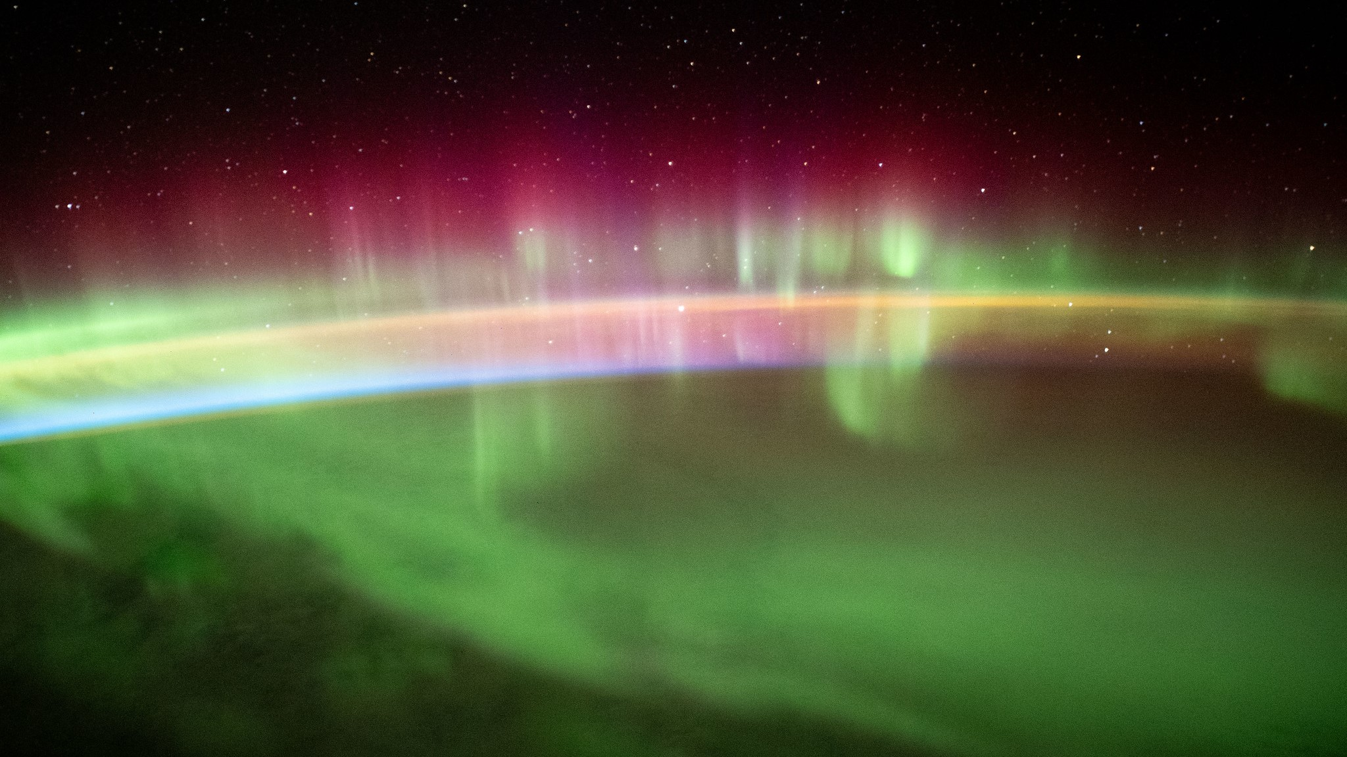
Physical mechanism
A one-way gate: EM events write the conductivity state; GWs read it out
Fast EM driver
Slow mechanical driver
Solar flare / HSS
→ enhanced ionization + precipitation
→ higher ionospheric conductivity
Conductivity memory (3–10 h) persists after EM forcing stops
EM unaffected by GW presence (no reverse gating)
Tropospheric gravity waves
arrive 6–24 h later
→ coupling efficiency depends on conductivity
asymmetry
Priming-window framework
Notes:
[Sources] - Provided materials: CORE-INSIGHT.md; short-note.md. - Background image (Aurora from ISS): https://www.space.com/auroras-from-space-station-video-august-2021 (image file served from cdn.mos.cms.futurecdn.net). [/Sources]

Slide 5
Timing is the control knob
Disturbance strength depends on alignment, not just driver intensity
Three clocks
EM (min–h)
Possible GW arrival times (6–24h transit)
Example intuition
Priming window (3–10h)
Moderate flare
+ GW 5h later
0h
2h
6h
10h
24h
Time since EM trigger
Amplified
Strong flare
(no GW)
Forecasting implication
Storm-time ionospheric response won’t scale cleanly with only solar-wind intensity or only weather intensity.
A moderate EM trigger followed by moderate GW forcing inside the window can outperform isolated “strong” drivers.
Lower net impact
Priming-window framework
Notes:
[Sources] - Provided materials: CORE-INSIGHT.md. [/Sources]

Slide 6
Model: conditional response operator
Replace a simple sum with a solar-history–conditioned coupling coefficient
Operator
Memory kernel shape (illustrative)
ΔObservable = EM_term + M(t) × GW_term
Memory kernel
M(t) = 1 + A · exp( −(t − t_EM)/τ )
A captures conductivity enhancement strength.
τ ≈ 4–8 h reflects recombination + plasma transport timescales.
M(t) decays back to ~1 as the ionosphere “forgets” the EM event.
Priming-window framework
Notes:
[Sources] - Provided materials: short-note.md; CORE-INSIGHT.md. [/Sources]

Slide 7
Λ: a dimensionless coupling intensity
Three regimes: sub-threshold, linear multiplicative, and amplified
Definition
Response vs Λ (illustrative)
Λ = rσ(t) × (E_GW / E₀)
rσ(t): conductivity enhancement relative to baseline.
E_GW: gravity-wave energy (or proxy) at thermospheric entry.
E₀: baseline threshold scale for noticeable ionospheric response.
Regimes
Λ < 1
Sub-threshold
1–3
Linear
> 3
Amplified
Λ=1
Λ=3
Priming-window framework
Notes:
[Sources] - Provided materials: CORE-INSIGHT.md; short-note.md. [/Sources]

Slide 8
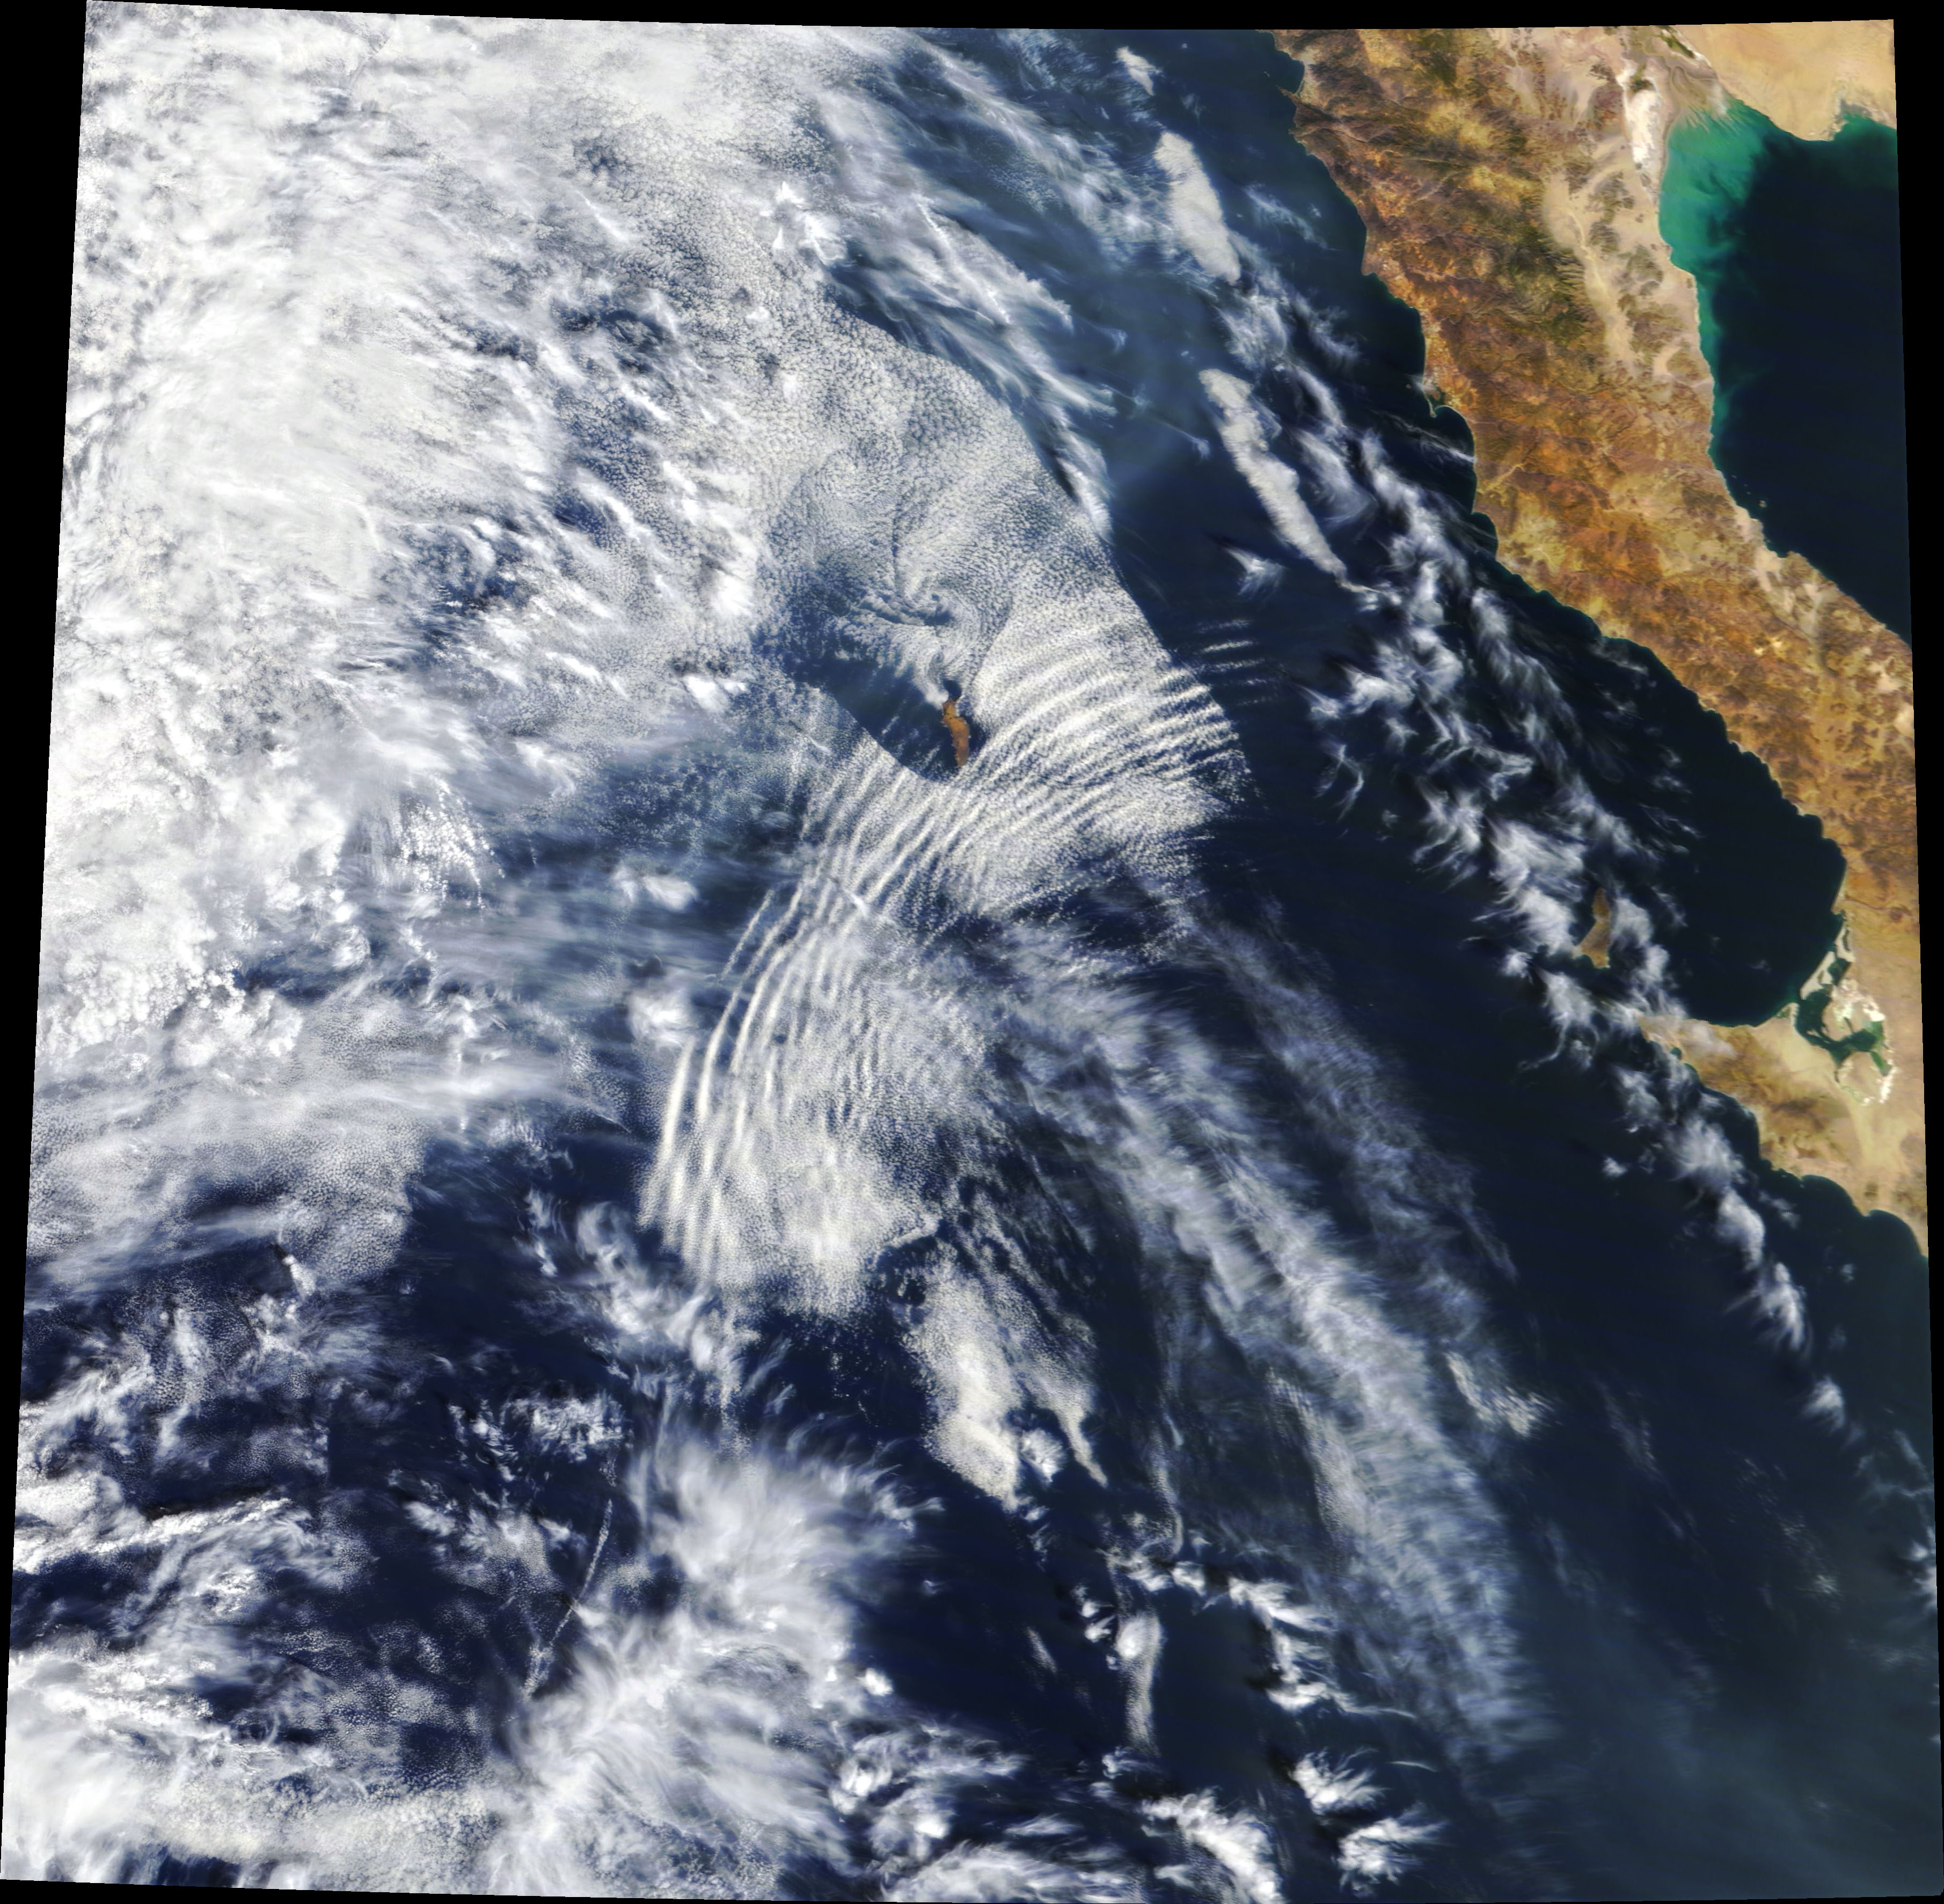
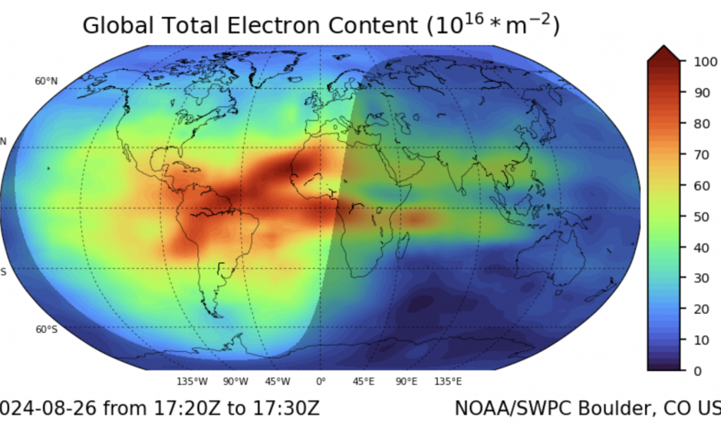
Supporting evidence (component mechanisms)
The priming-window effect is a synthesis of separately observed behaviors
1) EM → lower-atmosphere impacts
2) Conductivity persistence
3) GW coupling depends on state
High-speed solar-wind streams (HSS) precede precipitation enhancements by ~1 day (epoch analyses).
Suggests multi-timescale coupling and delayed atmospheric responses.
Flares rapidly enhance conductivity and currents.
Relaxation back to baseline can take hours — enabling a short-lived “memory”.
GW–ionosphere coupling varies with background collision frequency & conductivity.
Similar wave forcing can produce variable TEC responses under different conditions.
3–10h memory
Gravity-wave cloud bands (example)
Global TEC map (example)
Priming-window framework
Notes:
[Sources] - Provided materials: supporting-evidence.md; supporting-evidence-v2.md. - Gravity-wave imagery: NASA Earth Observatory / NASA SVS https://svs.gsfc.nasa.gov/14445 - Global TEC image: NOAA SWPC (GloTEC) https://www.swpc.noaa.gov/news/experimental-global-total-electron-content-glotec-ionospheric-model-available - Example evidence links referenced in provided materials: https://www.frontiersin.org/articles/10.3389/fspas.2023.1196231/full ; https://www.mdpi.com/2073-4433/12/9/1186 ; https://doi.org/10.1029/2018SW001932 [/Sources]

Slide 9
Testable predictions
A simple stratification by lag-to-EM trigger should expose the effect
Predictions
Minimal analysis pipeline
For matched GW energy flux, ΔTEC (and related F-region gradients) should be ~2–4× larger inside the 3–10 h window.
Amplification decays roughly exponentially with a 4–8 h time constant.
Binning events by Λ should reveal sub-threshold, linear, and amplified regimes.
1. Detect EM triggers
GOES X-ray flares; HSS arrival lists
2. Estimate rσ(t)
conductivity / current proxies; E-field records
3. Detect GW forcing
ERA5 GW proxies; convection/SCAPE; wave packets
4. Measure response
GNSS TEC; ionosondes; magnetometers
Key observable: superposed-epoch ΔTEC
stratified by lag (t_GW − t_EM)
5. Bin by lag & Λ
compare composites: inside vs outside window
Priming-window framework
Notes:
[Sources] - Provided materials: CORE-INSIGHT.md; short-note.md; supporting-evidence.md. [/Sources]

Slide 10
Forecasting implication
Treat solar activity as a modifier of atmospheric-wave coupling coefficients
Shift in modeling mindset
From: Response = f(EM) + g(GW)
To: Response = f(EM) + M(EM history) · g(GW)
Implementation sketch
Use short-term solar activity forecasts to modulate GW coupling coefficients
with an exponentially decaying memory kernel (τ ~ 4–8 h).
Solar drivers
Memory gate
Atmospheric waves
Ionospheric response
flares, HSS/CIRs
M(t), rσ(t)
GW sources + propagation
TEC, E-fields, currents
Priming-window framework
Notes:
[Sources] - Provided materials: CORE-INSIGHT.md; short-note.md. [/Sources]

Slide 11
Practical roadmap
What to build next to confirm (or falsify) the priming-window effect
01
Define event lists
EM triggers (GOES flare catalog; HSS arrivals) + GW forcing windows.
02
Compute rσ(t) & Λ
Use conductivity/current proxies + GW energy proxies to form Λ bins.
03
Run stratified composites
Superposed-epoch ΔTEC inside vs outside the 3–10h window.
04
Stress-test controls
Local time, season, geomagnetic latitude, background state, wave periods.
05
Operationalize
Turn M(t) into a forecast correction for whole-atmosphere models.
Priming-window framework
Notes:
[Sources] - Provided materials: short-note.md; supporting-evidence.md. - Background image (gravity-wave cloud bands): NASA Earth Observatory / NASA SVS https://svs.gsfc.nasa.gov/14445 [/Sources]

Slide 12
Takeaway
Timing alignment turns “additive” drivers into
a multiplicative response.
Next: validate with stratified superposed-epoch analyses and roll the gate into forecasts.
Appendix: evidence compilation in supporting-evidence.md
Notes:
[Sources] - Provided materials: CORE-INSIGHT.md; supporting-evidence.md. - Background image (Aurora from ISS): https://www.space.com/auroras-from-space-station-video-august-2021 [/Sources]

